Slide 1

My Dream Company

Slide 2
Present by :
MD. Galib Hossain
Md.galib _Dhaka_TUP_10_BDjobs

Slide 3
Index
Company profile
Business model
Driver of the company
Supply chain of amazon.com
Distribution channel
Partners
Amazon technology
Demand management 2

Slide 4
Company Overview
Amazon.com, Inc. (NASDAQ: AMZN) is an American-based multinational electronic commerce company.
Headquartered –Seattle, Washington.
Americas largest online retailer. Jeff Bezos founded Amazon.com, Inc. in 1994 and launched it online In 1995. It started as an online bookstore. With 2.5 million titles, it became the “Earth’s Biggest Bookstore”

Slide 5
Products
Books
Movie, Music and Games
Digital Download
Kindle
Computer And Office
Electronics
Home and garden
Grocery, Health and beauty
Toys, kids and baby
Clothing, Shoes and jewelry
Sports and outdoors
Tools, Auto and industrial

Slide 6
Business Model
Amazon-to-Buyer Sale Approach
Multi level E-Commerce• Customer Tracking
It operates 7 websites that support their business operation globally and offers 20 million items for sale.

Slide 7
Models for Web Application
There are 2 kind of web models
Conceptual model
Structural model

Slide 8
There are four primary drivers for growth :
1. Product focus
2. Customer focus
3. Technology focus
4. Distribution focus

Slide 9
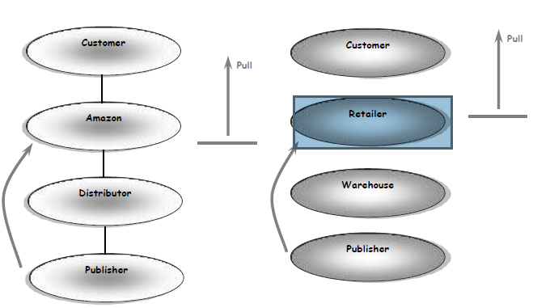
Supply chain of amazon.com

Slide 10
Multi-Tier Inventory Model
Inventory Aggregation respond to fluctuation in
demand with lower level of safety stock.
Inventory Aggregation respond to fluctuation in
demand with lower level of safety stock.

Slide 11
Partners

Slide 12
Technology Partners

Slide 13
Amazon Technology
It has world’s largest Linux Database, with a total capacity of 7.8 terabytes, 18.5 TB and 24.7 TB respectively.
The Central Amazon Data warehouse is made up of 28 Hewelett Packard server, with four CPUs per node, running Oracle 9i database software.

Slide 14
Five international stores of Amazon.com
Amazon Canada, Amazon France, Amazon UK, Amazon Japan, Amazon Germany.
Reasons:
 The Mother-Tongue Issue
 The Shipping Issue
 The Currency Issue
 The Local Product Issue
 The National Pride Issue
 Proper inventory control

Slide 15
Amazon Technology Architecture16

Slide 16
How deals the supply chains with fluctuating demand?
Amazon.com carries high-demand title in inventory, whereas it purchases lowed man titles from distributor in response to a customer orders .
Reduction in various costs like ;-
- Inventory cost
- Facility cost
- Transportation costs
- Information costs

Slide 17
What it means to me to work in this Organization
In my point of view, I find this organization, as an idea, to work for the better environment, not for me only but for the others also, be it people working in the organization and or the outside community.
To build a sustainable future to provide upcoming generation with positive morality while increasing their effectiveness so that the social-revolution never ends.

Slide 18


